Slide 1
TheraComm
Christian John
Iden Ellia
Joe Samano

Slide 2
Problem
1

Slide 3



Slide 4
Client
2

Slide 5

Online Therapy Unit Team
A team that is dedicated to improving access to mental health care.

Slide 6
What is TheraComm?
3

Slide 7
What is TheraComm?
TheraComm is an iOS-based mobile application that incorporates the core features of an email system and a chat system.

Slide 8
Software Development Process
4

Slide 9
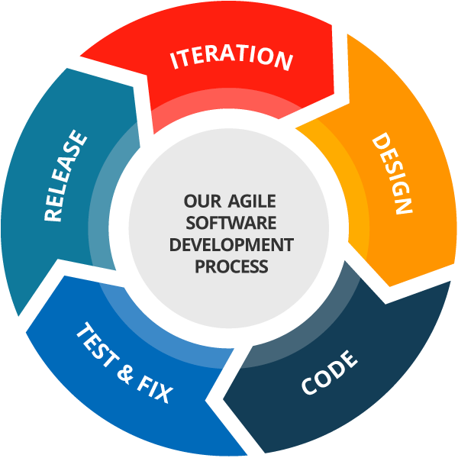
Agile Development
Sprint 1 - Making the Email API work and the Interface of Email System (2 weeks)
Sprint 2 - Functionalities and Remaining Interface of Email System (2 weeks)
Sprint 3 - Interface and Functionalities of Chat System (4 weeks)

Slide 10
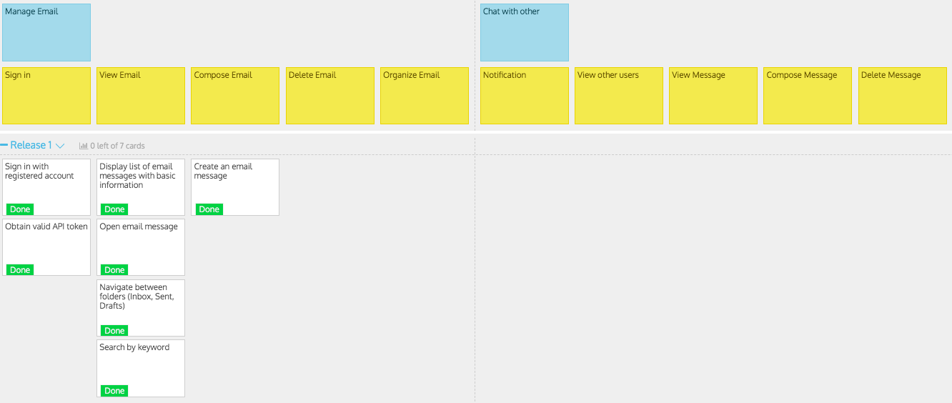
User Story Map - Sprint 1

Slide 11
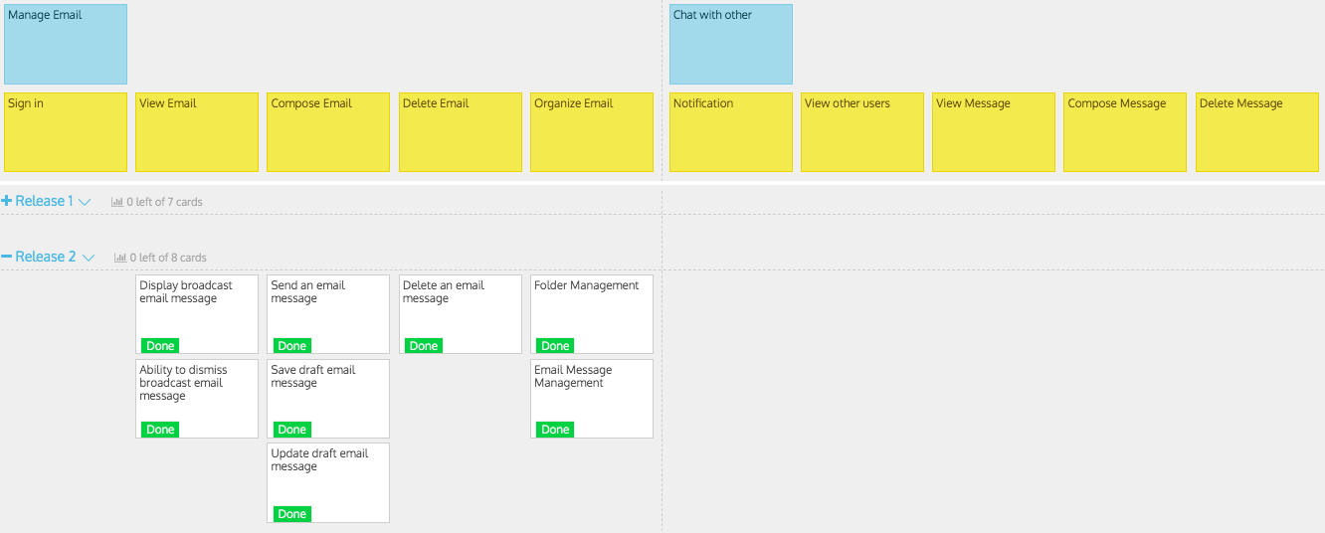
User Story Map (Continued) - Sprint 2

Slide 12
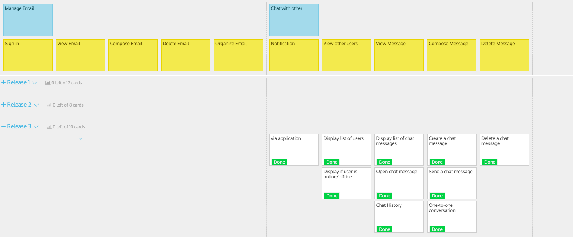
User Story Map (Continued) - Sprint 3

Slide 13
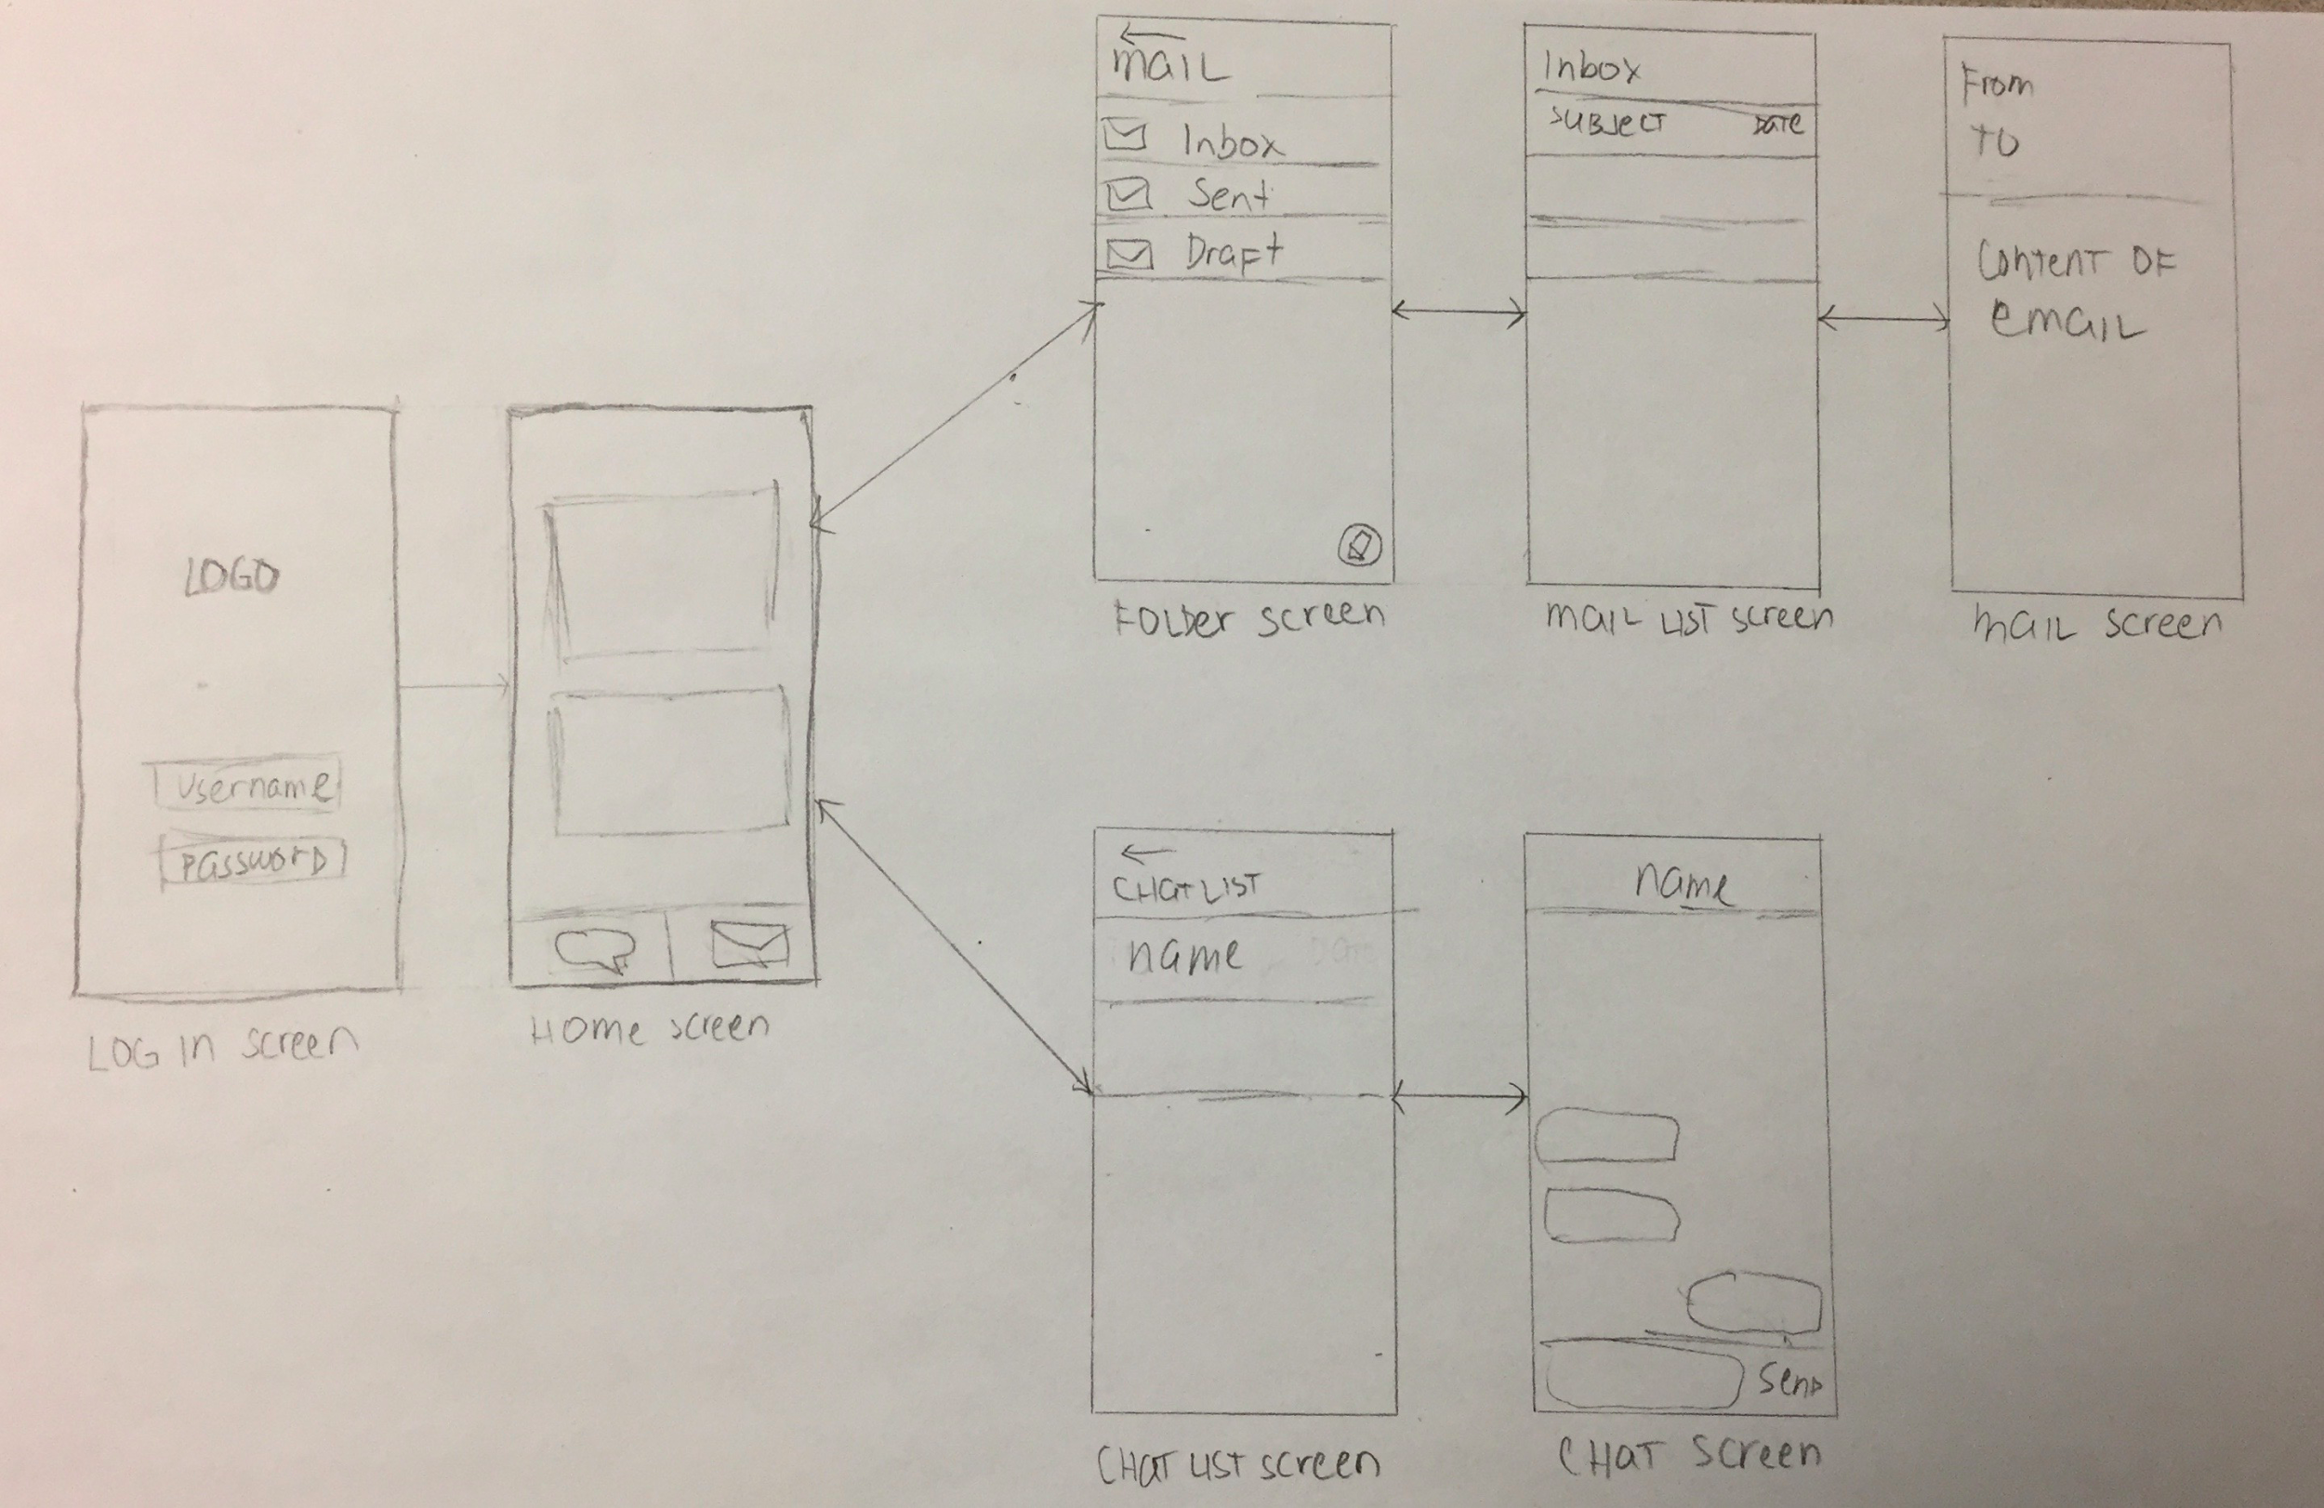
Lo-Fi Prototypes

Slide 14
Testing
Unit Testing
Integration Testing
System Testing
Functional Testing

Slide 15










Technologies

Slide 16
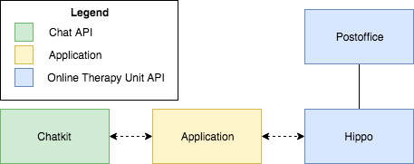
High-Level View of Architecture

Slide 17
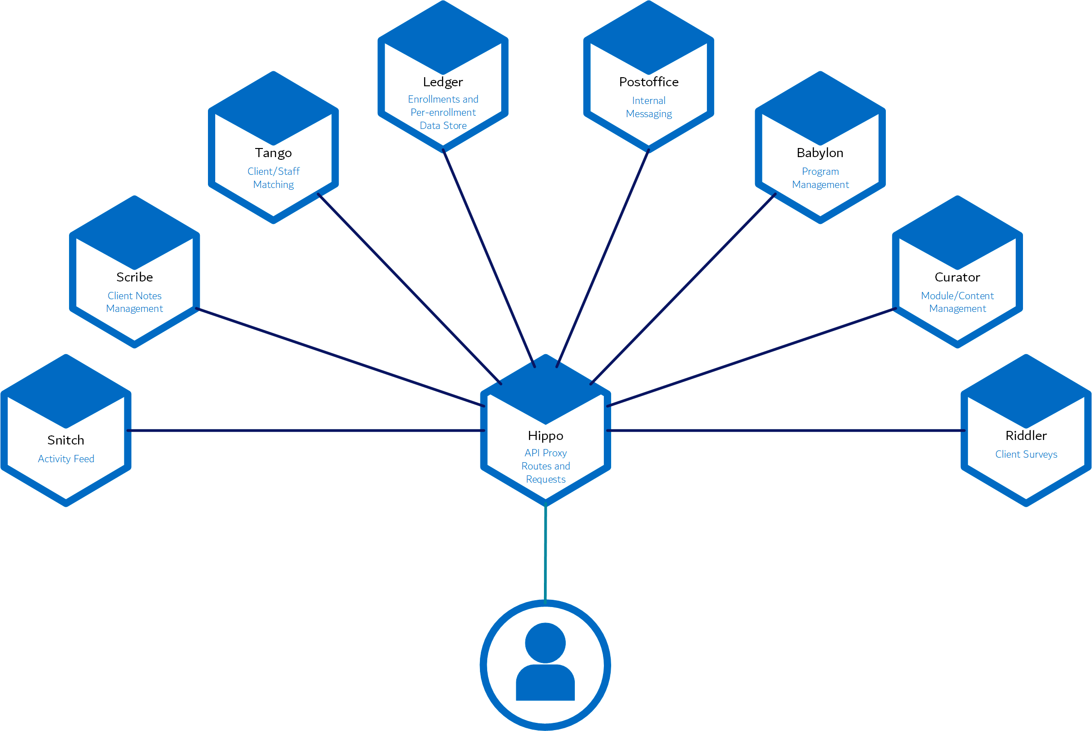
Email System - Online Therapy Unit API
Hippo - API Proxy
Postoffice - Internal Messaging System

Slide 18
Chat System
Chatkit - a third party extensible API to build in-app messaging
Laravel - a free, open-source PHP web framework

Slide 19
Application
Swift - programming language for iOS
CocoaPods - dependency manager for Swift Projects
Xcode - is the IDE used for developing OS X and iOS software

Slide 20
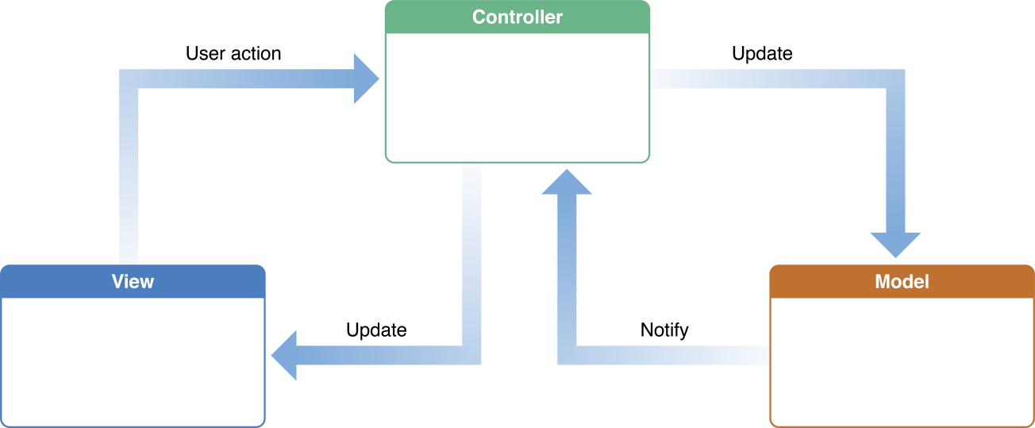
Apple’s MVC - Architectural / Design Pattern

Slide 21
Model
The object that encapsulates the data and the logic of the application.

Slide 22
View
The object in an application that the user sees.

Slide 23
Controller
The object that acts as an intermediary between the model and view.

Slide 24
Revision Control - Github
A web-based hosting service for version control using Git.

Slide 25
Others
GitKraken - a Git GUI client.
StoriesOnBoard - a User Story Mapping Tool for Agile Product Management.
Toggl - a Time Tracking application

Slide 26
Demo
5

Slide 27
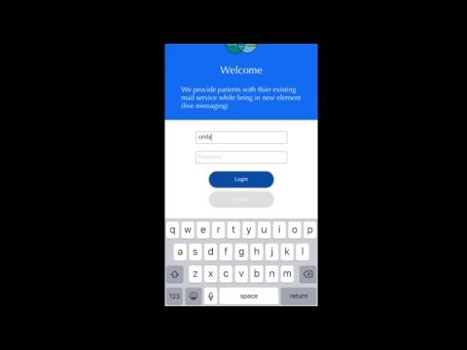
Push Notifications
View of the System

Slide 28
Email System

Slide 29

Push Notifications
Sending Email

Slide 30
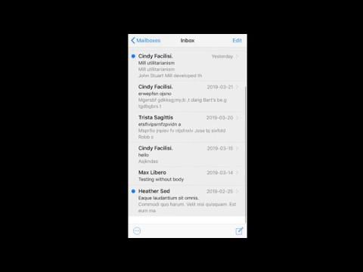
Push Notifications
Deleting Email/Folder

Slide 31
Push Notifications
Creating Folder

Slide 32
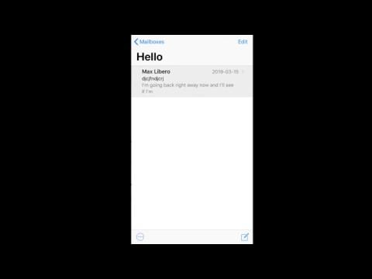
Push Notifications
Moving Email Between Folders

Slide 33
Chat System

Slide 34
Push Notifications
Creating Room
Adding People
Sending Message

Slide 35
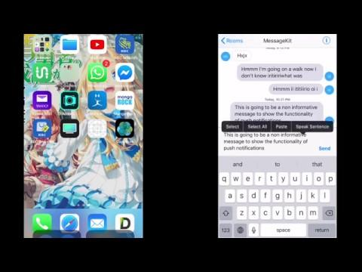
Push Notifications
Push Notification

Slide 36
Future Works
6

Slide 37
Future Works
Addition of other features from OTU API:
Viewing Courses
Surveys
Etc.
Add more features to the existing application:
Sub-folders
Video Chat
Etc.

Slide 38
THANKS!
Any questions?

Slide 39
Image References
Depression, https://pixabay.com/illustrations/depression-voices-self-criticism-1250870/
Therapy Session, http://chittagongit.com/icon/therapist-icon-10.html
Agile Development Process, http://www.webmix.fr/en/methodologies
Toggl Logo, https://www.pivotaltracker.com/integrations/toggl-button
Swift Logo, https://zh.m.wikipedia.org/wiki/File:Swift_logo_with_text.svg
Xcode Logo, https://www.macosicongallery.com/icons/xcode-2015-03-13/
Online Therapy Unit Logo, https://www.onlinetherapyuser.ca/
StoriesonBoard Logo, https://storiesonboard.com/
Chatkit Logo, https://pusher.com/chatkit
Laravel Logo, https://logos-download.com/9720-laravel-logo-download.html
MVC Architecture, https://developer.apple.com/library/archive/documentation/General/Conceptual/DevPedia-CocoaCore/MVC.html
Github Logo, https://ievgensaxblog.wordpress.com/2017/11/04/me-on-github/
GitKraken Logo, https://www.gitkraken.com/store
Cocoapods Logo, https://status.cocoapods.org/

Slide 40
Appendix
Link to github: https://github.com/samano2j/Capstone-Project
Link to documentation: https://github.com/samano2j/Capstone-Project/tree/master/Documentation
Link to testing documentation: https://github.com/samano2j/Capstone-Project/tree/master/Documentation/Test%20Plan%20and%20Execution%20Document
Link to User Story Map: https://landofooo.storiesonboard.com/m/theracomm
Link to OTU website: https://www.onlinetherapyuser.ca/
Link to OTU Documentation: http://otu-wiki.cs.uregina.ca/start
Link to Toggl: https://toggl.com/app/timer
Link to Chatkit Features: https://pusher.com/chatkit/pricing
Link to Chatkit Documentation: https://docs.pusher.com/chatkit
Link to Chatkit Data Protection: https://pusher.com/legal/data-protection

